Slide 1
Summary of 'Some of My Best Friends Are Germs' article
Name:
Institution:
Date:

Slide 2
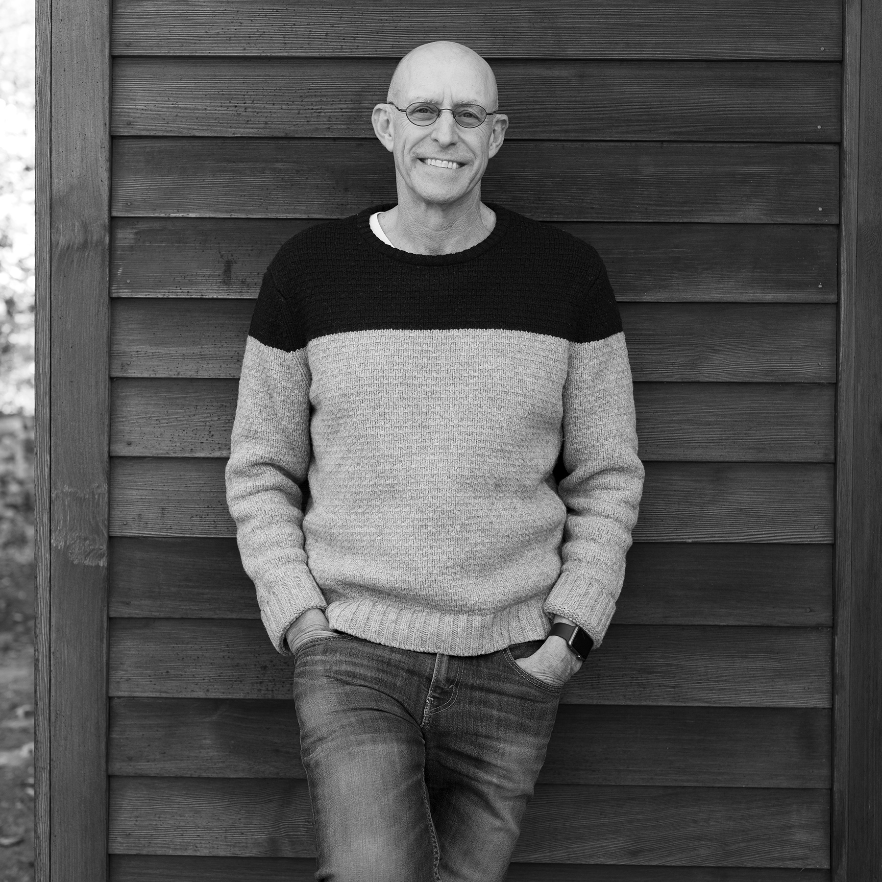
Biography
Michael Pollan is an author of books and articles about places where the human and natural worlds intersect: in our minds, or plates and our farms and gardens.
Pollan's books have won various awards for example, the California Book Award and the James Beard Award for best food writing ("About Michael Pollan « Michael Pollan," n.d.).
Pollan also received an honorary doctorate from the University of Gastronomic Science and was at the Radcliffe Institute for Advanced Study at Harvard in 2015-2016.
Michael Polland, is very convincing in his article because he presents evidence and shows his excitement about the topic which cannot be ignored.
Notes:
Michael Pollan is an author, with articles and books which have won various awards for example The California Book Award and the Northern California Book Award. He also has an honorary doctorate from the University of Gastronomical Sciences and studied at Harvard in 2015-16.

Slide 3
Biography (continuation)
In 2003, Pollan was appointed as Professor of Journalism at UC Berkeley's Graduate school of Journalism
He was also appointed director of the Knight Program in Science and Environmental Journalism.
In 2017, he was appointed Professor of Practice of non-fiction at Havard and the university's first Lecturer in the arts.
In 2020, along with Dacher Keltner and others he co-founded the UC Berkeley Center for Science of Psychedelics.
The Center investigates cognition, perception and emotion and their biological bases in the human brain.
Notes:
Michael Pollan was also appointed Professor of Journalism at UC Berkeley's school of Journalism and director of the Knight program. In 2017 he was appointed Professor of Practice of non-fiction at Havard and in 2020 he co-founded the UC Berkeley Center for Science of Psychedelics, which investigates cognition perception and emotion and their biological bases in the human brain

Slide 4
The author's main point
The author is talking about microbes, which are microorganisms or microscopic organisms that exist as unicellular, multicellular, or cell clusters.
He goes on to explain how they widely inhabit the human body, which are around 100 trillion in the body, living and dying in the body
He makes a humorous point stating that we are 10 percent human, because for every human cell, there about 10 microbes (Pollan, 2013).
The author makes it clear that the microbes are also very beneficial to life and expounds a lot on such benefits.
Notes:
The main point of the author is microbes, particularly human-associated microbes, and how they inhabit the human body. He also talks about their functions and puts an emphasis on how they positively affect us and how we can live healthily with them.

Slide 5
The article's purpose
The article's title 'Some of My Best Friends Are Germs' speaks a lot about the purpose in which Michael Pollan wrote this article.
When Michael Pollan received an email with huge chunks of file and raw data from the American Gut project which had done an analysis of his microbiome in a laboratory.
His test results led him to the research of microbes and looking into their benefits and harm to life, and how to live healthily with them.
He explains what we as a civilization are doing to wreck the human-related microbiota with an unhealthy diet and lifestyle.
Notes:
The purpose of this article is to show how microbes affect the human body and how we can live healthily with them Michael Pollan starts by giving a background on how he came about the knowledge of microbes from a test done on himself. He then goes on to show how we have been living in ways that are a threat to our natural microbes, yet they are essential to us for such like digestion and strengthening the immune system.

Slide 6
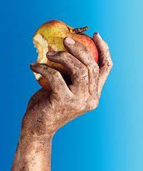
The article's purpose
The article's title 'Some of My Best Friends Are Germs' speaks a lot about the purpose in which Michael Pollan wrote this article.
When Michael Pollan received an email with huge chunks of file and raw data from the American Gut project which had done an analysis of his microbiome in a laboratory.
His test results led him to the research of microbes and looking into their benefits and harm to life, and how to live healthily with them.
He explains what we as a civilization are doing to wreck the human-related microbiota with an unhealthy diet and lifestyle.

Slide 7
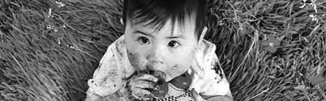
The article's purpose (continued)
Michael Pollan audience is his curious readers who are interested in knowing how nature and human beings relate to one another.
He addresses his concerns to his audience on how we are suffering loss by passing on fewer microbes to the next generations. (Pollan, 2013).
So important are these microbes in the human body that after the author had just been on antibiotics his healthy levels of prevotella had disappeared and replaced by harmful bacteria.
The author gives his audience ways in which to cultivate the natural microbes in a healthy manner.

Slide 8
The article's publication date
Published in May 2013, the article is somewhat current therefore contemporaneous with a related topic to be researched during this period.
The article can be used as a source of reference researching on an up-to-date topic on human-related microbes.
The article is a good source of information because of the date, therefore the creators are concerned with giving the audience as much information as possible.
The article provides sufficient coverage of the topic concerned, and it has a wide focus fulfilling the researcher's needs.
Notes:
The article is a current one, published in 2013, which indicated its credibility in being used as a source of research material and for citation. It provides a good information on the subject matter and also covers sufficiently and widely the topic concerned.

Slide 9
Use of Voice
The author uses voice in the article which directly adds to tone and mood.
  Well-thought choice of words.
  Diction
  Point of view
The tactics assist to achieve the central purpose of the article.

Slide 10
Why the article was worth publishing
The editor found this article worth publishing because it goes in depth about human-associated microbes.
Though the article uses a lot of scientific vocabulary, it is easy for non-scientific readers to understand it, and that's why it was published by the New York Times.
    The article incorporates scientific sources and peer reviewed articles to support the claims and ideas .
The article is beneficial to everyone reading it, and contains simple instructions for cultivation of microbes for example taking foods rich in fibre or fermented (Pollan, 2013).
The article also has a good flow of information because the author seeks to break down his information to smaller details.
Notes:
The article goes deep in explaining about human-related microbes and their benefits to metabolism and the immune system. It is worth reading and easy to understand despite use of a lot of scientific terms. The article benefits all readers and has a good flow of information making it understandable.

Slide 11
The writer's communication
The author uses a lot of scientific vocabulary explaining different components in the human body and different types of microbes.
He uses convincing words to affirm his readers that he truly knows what he is talking about and to persuade them to take his information into consideration.
The writer also creates an open and comfortable environment for the reader by sharing is personal experiences.
The article reveals that he has a sense of humour, for example when he says that he's never heard so much discussion of human faeces at dinner (Pollan, 2013).
Notes:
The writer uses much scientific vocabulary in the article concerning the human body and microbes. He also uses convincing words as a means of persuading his readers. The writer also creates comfortability by sharing his personal experiences with the reader and through his sense of humour.

Slide 12
The writer's approach to his audience
Generally, the writer's approach is a friendly one seen by his revealing of personal information and experiences and in being humorous.
His friendliness also comes out in his humor, like how he calls the microbes his best friends in the article title.
The writer uses ethos when he references professionals in the biology field like Catherine A. Lozupone and Rob Knight to show credibility of his information.
The writer uses pathos by evoking excitement in the reader to follow his instructions in order to lead a healthy lifestyle.
The writer uses logos by outlining outcomes and statistics like the test involving 14 commercial probiotics.
Notes:
The writer's approach is a friendly one felt when he shares his personal information and experiences with his audience, and also through his humor. The writer uses ethos to show credibility of his information, pathos to evoke excitement in the reader and logos to showcase statistics backing up his information.

Slide 13
The writer's evidence
The writer backs up his information with personal evidences such as the lab test done on him that led him to research into human-associated microbes.
The author also references different source materials, for example the article 'Diversity, Stability and Resilience of the Human Gut Microbiota' (Pollan, 2013).
The author also gets his information from talks with and interviews he has done on experts in the fields of microbiology, for example, he interviewed Catherine A. Lozupone in Boulder.
I agree with the writer mainly because of the credibility of his evidences especially from other experts.
Notes:
The writer uses personal evidence about his information such as lab tests done on him, and also uses different source materials from credible sourches like artocles from professionals in the biology field. The author also interviews professionals on the subject matter. The credibility of his evidences makes his information true therefore agreeable.

Slide 14
Counter Arguments in the article
One counter argument is seen where it is stated that there was a recent study linking to certain gut microbes common in meat eaters that suggested prevotella (a beneficial microbe) was one such microbe.
Another one is the argument against the point that people with H. pylori get peptic ulcers while H. pylori is used to regulate various metabolic and immune functions.
The last but not least counter argument is the one against antibiotics; that they reduce and even destroy the human microbiome, particularly that relating to the immune system.
Notes:
The author offers several counter arguments in the articles, for example the one suggesting high number of prevotella microbes in meat eaters whereas much meat is unealthy, and the benefit of H. Pylori to metabolism and immunity even though it causes peptic ulcers. Another counter agrument is against antibiotics for their reduction in human microbiome.

Slide 15

Questions
The writer focuses more on the benefits of human-related microbes. Are there microbes that cause harm to the body? And if so, what kinds of harm do they cause?
For a microbe to be considered somewhat 'healthy', what should it look like and what should it do?
According to the writer, what are some of the ways one can healthily cultivate the growth of naturally occurring microbes that are beneficial to the immune system and the gut?

Slide 16
References
About Michael Pollan « Michael Pollan. (n.d.). Michael Pollan. https://michaelpollan.com/about/
Pollan, M. (2013, May 15). Some of my best friends are germs (Published 2013). The New York Times - Breaking News, US News, World News and Videos. https://www.nytimes.com/2013/05/19/magazine/say-hello-to-the-100-trillion-bacteria-that-make-up-your-microbiome.html
Notes:
Another preventive and control method is offering of counselling services like rehabilitation and therapy to those struggling with substance abuse. Also, behavioral monitoring is a great strategy to identify the vulnerable to substance abuse in order to teach them so that they may not engage in it.

